Slide 1
MEMS devices for biomedical applications

Slide 2
Micro-Electro-Mechanical Systems (MEMS) are a class of miniature devices and systems fabricated by micromachining processes. MEMS devices have critical dimensions in the range of 100 nm to 1000 µm (or 1 mm). MEMS technology is a precursor to the relatively more popular field of Nanotechnology, which refers to science, engineering and technology below 100 nm down to the atomic scale. Occasionally, MEMS devices with dimensions in the millimeter-range are referred to as meso-scale MEMS devices

Slide 3
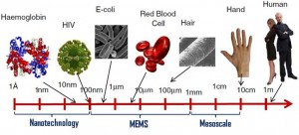
relevant dimensional scale alongside biological matter

Slide 4
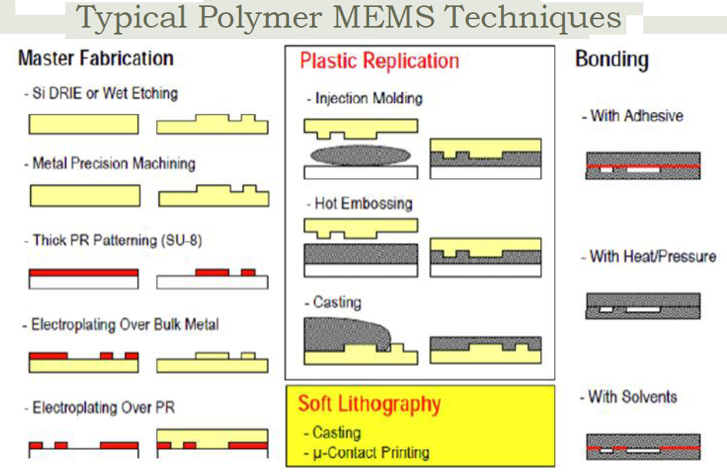

Slide 5
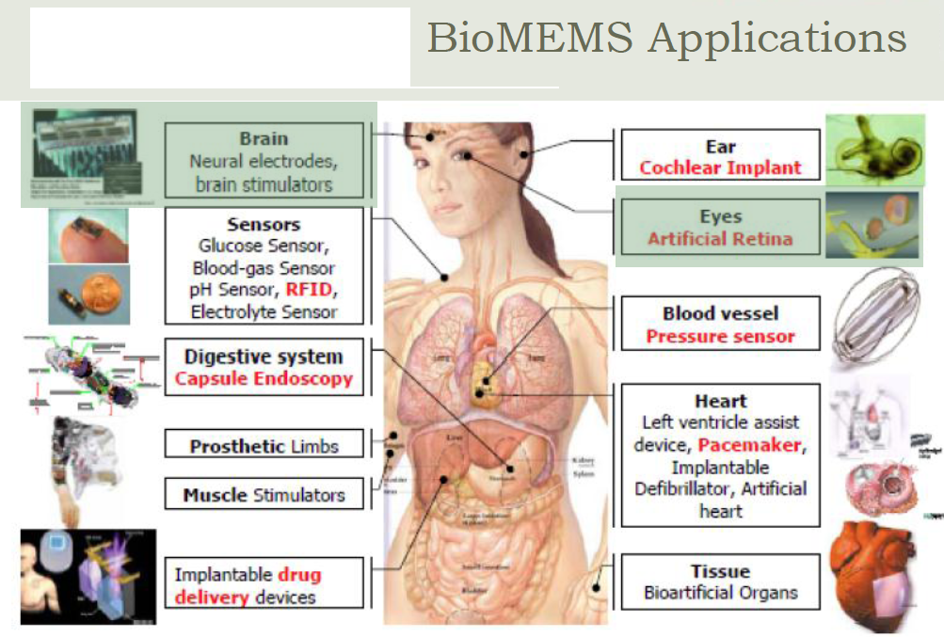

Slide 6
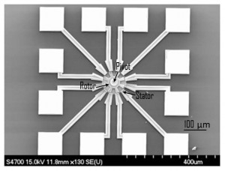
MEMS technology was based on silicon using bulk micromachining and surface micromachining processes. An SEM image of a MEMS electrostatic motor an SEM image of a surface micromachining based polysilicon MEMS device, an electrostatic motor, which consists of twelve fixed stator electrodes and a rotor that spins around the pivot at its center. Gradually, other materials such as glass, ceramics and polymers have been adapted for MEMS.

Slide 7
MEMS devices can actuate or sense on a micro-scale. MEMS devices can function individually or in combination with other devices to generate effects of meso- or macro- scale. Some advantages of MEMS devices include small size, light weight, low power consumption and high functionality compared to conventional devices. Further, MEMS technology offers cost reduction due to batch processing techniques similar to semiconductor Integrated Circuit (IC) manufacturing. Initially, MEMS technology emerged as an offshoot of the semiconductor industry and eventually established itself as a specialized field of study with a significant market share. According to Yole Développement, the MEMS industry market in 2012 was $11 billion, which is a 10 percent growth from the previous year

Slide 8
MEMS applications MEMS applications in various functional domains. The term “functional domain” is used to refer to a domain in which the MEMS device performs a function such as sensing or actuation. In the early stages, MEMS proved to be a revolutionary technology in various fields of the physical domain such as Mechanical (e.g., Pressure sensors, Accelerometers, and Gyroscopes), Microfluidics (e.g., Inkjet nozzles), Acoustics (e.g., Microphone), RF MEMS (e.g., Switches and Resonators), and Optical MEMS (e.g., Micromirrors). Gradually, MEMS technology has demonstrated unique solutions and delivered innovative products in chemical, biological and medical domains as well. MEMS have penetrated into consumer electronics, home appliances, automotive industry, aerospace industry, biomedical industry, recreation and sports

Slide 9
Typically, electronics are used to interface MEMS devices from its functional domain (i.e., Physical, Chemical, or Biological) to the electrical domain for signal transduction and/or recording. It should be pointed out that the term MEMS was originally coined to refer to miniature sensors and actuators operating between electrical and mechanical domains. Gradually, the term MEMS has evolved to encompass a wide variety of other microdevices fabricated by micromachining. For example, a micromachined electrochemical sensor is referred to as a MEMS device even though there is no functional role played by this device in the mechanical domain. Similarly, the term “BioMEMS” is used to refer to the science and technology of microdevices fabricated by micromachining for biological and medical applications. BioMEMS may or may not include any electrical or mechanical functions. BioMEMS application areas include biomedical transducers, microfluidics, medical implants, microsurgical tools, and tissue engineering. As shown in Figure 4, the global BioMEMS market is expected to almost triple in size, from $1.9 billion in 2012 to $6.6 billion in 2018

Slide 10
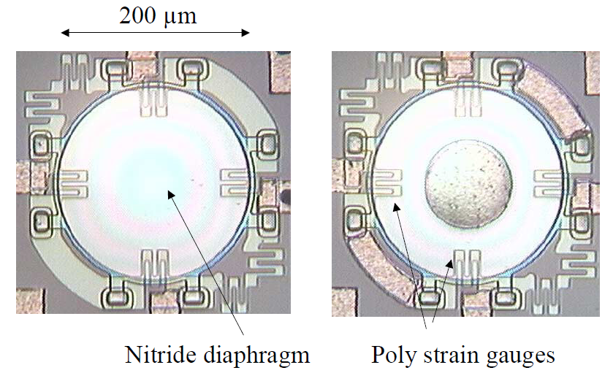
MEMS Pressure Sensors The first MEMS devices to be used in the biomedical industry were reusable blood pressure sensors in the 1980s. MEMS pressure sensors have the largest class of applications including disposable blood pressure, intraocular pressure (IOP), intracranial pressure (ICP), intrauterine pressure, and angioplasty. Some manufacturers of MEMS pressure sensors for biomedical applications include CardioMEMS, Freescale semiconductors, GE sensing, Measurement Specialties, Omron, Sensimed AG and Silicon Microstructures

Slide 11
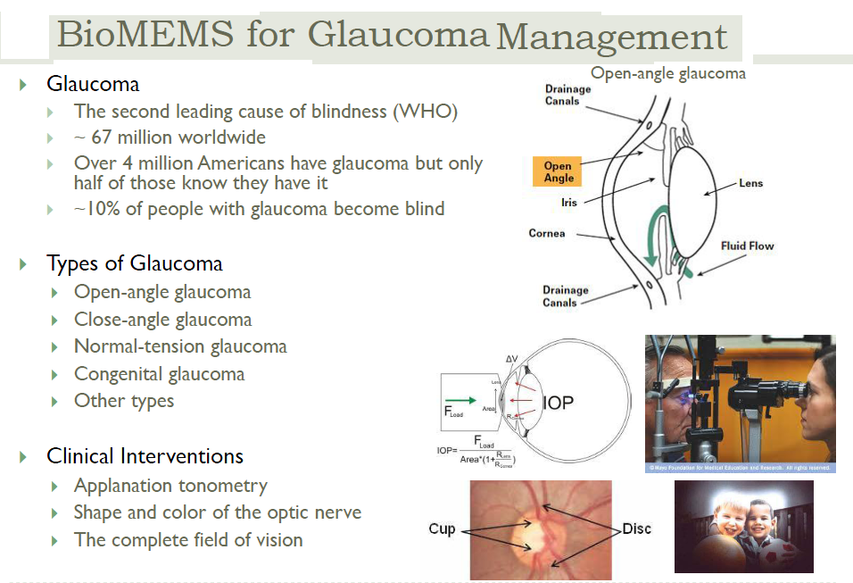

Slide 12
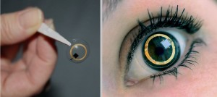
Sensimed’s TriggerfishTM implantable MEMS IOP sensor

Slide 13
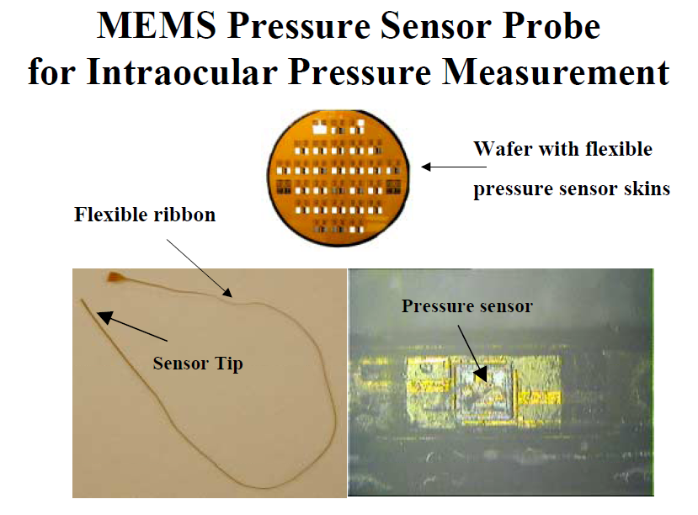

Slide 14
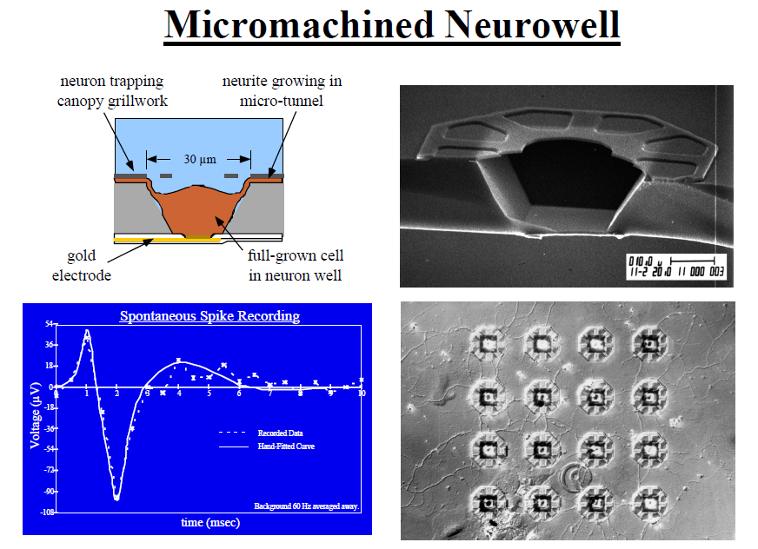

Slide 15
MEMS Inertial Sensors MEMS accelerometers are used in defibrillators and pacemakers. Some patients exhibit unusually fast or chaotic heart beats and thus are at a high risk of cardiac arrest or a heart attack. An implantable defibrillator restores a normal heart rhythm by providing electrical shocks to the heart during abnormal conditions. Some peoples’ hearts beat too slowly, and this may be related to the natural aging process or a genetic condition. A pacemaker maintains a proper heart beat by transmitting electrical impulses to the heart. Conventional pacemakers were fixed rate. Modern pacemakers employ MEMS accelerometers and are capable of adjusting heart rate in accordance with the patient’s physical activity. Medtronic is a leading manufacturer of MEMS based defibrillators and pacemakers. Figure 6 shows a MEMS accelerometer-based Medtronic’s SureScanTM pacemaker and implantation of a pacemaker inside the body next to the heart. This pacemaker is designed to be compatible with magnetic resonance imaging (MRI).

Slide 16
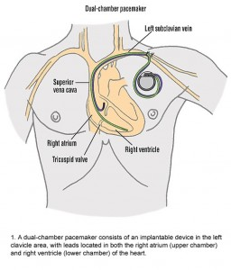
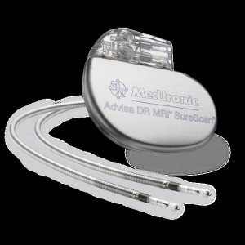
a MEMS accelerometer-based Medtronic’s SureScanTM pacemaker and implantation of a pacemaker inside the body next to the heart.

Slide 17

MEMS inertial sensors (accelerometers and gyroscopes) were employed to develop one of the most unique wheelchairs, the iBOTTM Mobility system. A combination of multiple inertial sensors in this system enables the user to operate the wheelchair and lift to a standing height just balancing on two wheels. This allows the wheelchair user to interact with others face-to-face. The iBOTTM system was developed by Dean Kamen in a partnership between DEKA and Johnson and Johnson’s Independence Technology division. Unfortunately, it is no longer available for sale from Independence Technology. Another related example is the Segway PT, a two-wheeled, self-balancing, battery-powered electric vehicle, also invented by Dean Kamen. It is produced by Segway Inc. of New Hampshire, USA

Slide 18
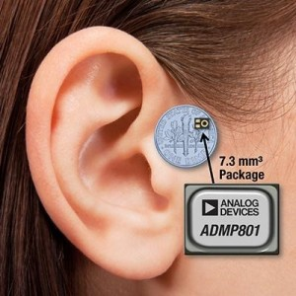
MEMS Hearing-Aid Transducer A hearing-aid is an electroacoustic device used to receive, amplify and radiate sound into the ear. The goal of a hearing aid is to compensate for the hearing loss and thus make audio communication more intelligible for the user. In the US, hearing aids are considered medical devices and are regulated by the FDA. According to NIH, approximately 17 percent (36 million) of American adults report some degree of hearing loss. There is a strong relationship between age and reported hearing loss. Also, about 2 to 3 out of every 1,000 children in the United States are born deaf or hard-of-hearing
Analog Devices MEMS microphone for hearing-aid applications

Slide 19
Microfluidics for diagnostics Microfluidics involve movement, mixing and control of small volumes (nanoliters) of fluids. A typical microfluidic system is comprised of needles, channels, valves, pumps, mixers, filters, sensors, reservoirs, and dispensers. Microfluidics enable bedside or at the point-of-care (POC) medical diagnosis. Especially, POC diagnosis is important in developing countries where access to centralized hospitals is limited and expensive. A POC diagnostic microfluidic system uses bodily fluids (saliva, blood, or urine samples) to perform sample preconditioning, sample fractionation, signal amplification, analyte detection, data analysis, and results display. In 1985, Unipath introduced the first POC microfluidic device, ClearBlueTM, for pregnancy test from urine sample and is still available on the market. Recently, a comprehensive review article on the commercialization of microfluidic devices for POC diagnostics was published by Chin et al

Slide 20

Microfluidics for drug delivery Microfluidics enable advanced drug delivery technologies such as triggered release, timed release and targeted delivery. Some applications include transdermal drug delivery (e.g., microneedle arrays and needle-less jet-based system), implantable drug delivery systems (e.g., drug-eluting stents and insulin pump), and drug delivery vehicles (e.g., micro- and nano– particles).
Attachment of the system to the body using a disposable skin patch (left) JewelPUMPTM (middle) and programmable remote controller (right)
This system was developed by Debiotech in collaboration with STMicroelectronics. The MEMS nanopumpTM mounted on a disposable skin patch provides continuous insulin through jet-based infusion delivery. The whole system weighs only 25 grams and holds up to 500 units of insulin and can be used for a 7 day period without any need for refill or replacement. The JewelPUMPTM is directly programmed from a large display remote controller. It can be attached to the body using a disposable skin patch and can be detached when necessary, thereby offering more freedom to the patient

Slide 21
Micromachined needles Micromachining enables fabrication of needles smaller than 300 µm, which is the limit of conventional machining methods. Typically, the length of the MEMS-based microneedles is less than 1 mm. Microneedles have been used for drug delivery, bio-signal recording electrodes, blood extraction, fluid sampling, cancer therapy, and microdialysis. Frequently, microneedles are integrated and used in conjunction with microfluidic systems. Solid and hollow microneedles have been fabricated out of silicon, glass, metals, and polymers using micromachining processes. Microneedles have been demonstrated with various body shapes (cylindrical, canonical, pyramid, candle, spike, spear, square, pentagonal, hexagonal, octagonal and rocket shape) and tip shapes (volcano, snake fang, cylindrical, canonical, micro-hypodermis and tapered).

Slide 22
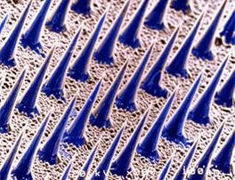
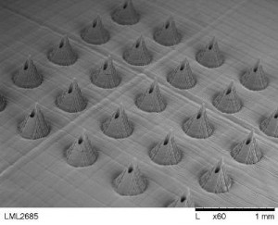
Micromachined needles: silicon based solid needles
Micromachined needles: polymer based hollow needles

Slide 23
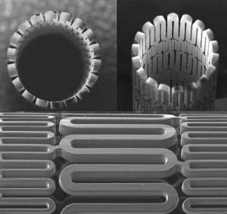
Cardiovascular disease continues to be the leading cause of death in the United States. One of the common fatal cardiovascular conditions is narrowing of blood vessels due to accumulation of plaque that can lead to heart attack, stroke and other serious issues. Angioplasty is a procedure designed to restore normal blood flow through clogged or blocked arteries. A cardiac stent is inserted into a blood vessel via a catheter and then expanded to enlarge the vessel. There are two general types of stents: Metal stents and polymer stents. Metal stents are the conventional type. Two main types of polymer stents are resorbable and nonresorbable. The former type is attractive as it may be absorbed or dissolved inside the body
Micromachined resorbable polymer stent

Slide 24
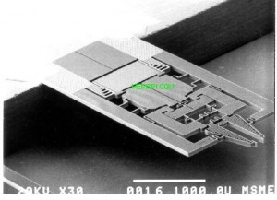
Microsurgical tools Surgery is treatment of diseases or other ailments through manual and instrumental methods. In surgery, the majority of trauma to the patient is caused by the surgeon’s incisions to gain access to the surgical site. Minimally invasive surgical (MIS) procedure aims to provide diagnosis, monitoring, or treatment of diseases by performing operations with very small incisions or sometimes through natural orifices. Advantages of MIS over conventional open surgery includes less pain, minimal injury to tissues, minimal scarring, reduced recovery time, shorter hospital visits, faster return to normal activities and often lower cost to the patient. Common MIS procedures include angioplasty, catheterization, endoscopy, laparoscopy, and neurosurgery. MEMS based microsurgical tools have been identified as a key enabling technology for MIS
Micromachined surgical tools: a pair of silicon MEMS tweezers

Slide 25
Micromachined needles: silicon based solid needles
Micromachined needles: polymer based hollow needles

